Slide 1

A gamified introduction to Python Programming Lecture 6 Everything about for loops
Matthieu DE MARI – Singapore University of Technology and Design

Slide 2

Outline (Chapter 6)
What is the list type? (quick intro, more on this later)
What is a for loop and how to implement a basic one using a list as generator?
What is the range() generator?
What is the zip() generator?
What is the enumerate() generator?
What are nested for loops?
What is breaking and continuing in for loops?

Slide 3
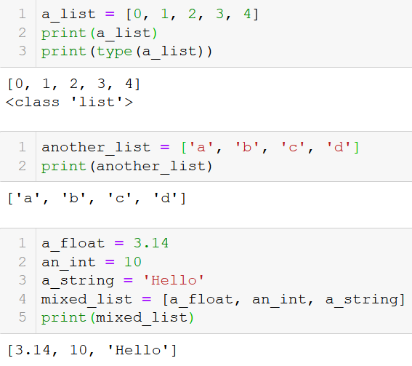
The list type (short intro)
Let us first introduce a new type of objects, called lists.
Definition (lists): a list is a sequence of several variables or elements, listed, in order, between brackets and separated by commas.
Lists can contain variables of any types (int, float, string, etc.) and lists can also contain mixed types of variables.

Slide 4
The list type (short intro)
Let us first introduce a new type of objects, called lists.
Definition (lists): a list is a sequence of several variables or elements, listed, in order, between brackets and separated by commas.
Lists can contain variables of any types (int, float, string, etc.) and lists can also contain mixed types of variables.
We will learn more about lists in the next coming lectures!

Slide 5
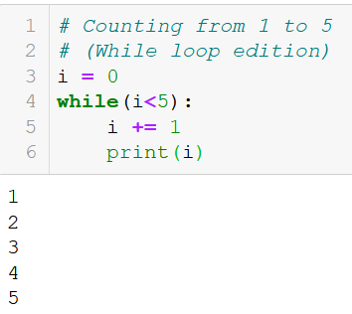
The for statement
Sometimes in programming, there is a block of code that you want to repeat for a fixed or given number of times.
It could be done with a while statement, but there is a more convenient way.
The more convenient way: A for statement is used to repeat a given block of code for a given number of times.

Slide 6
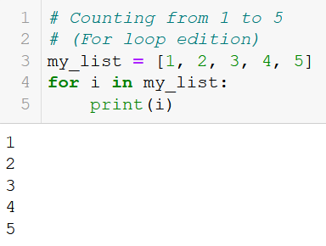
The for statement
The for loop - How it works:
Use the for keyword,
It is immediately followed by a variable name, called an iteration variable,

Slide 7
The for statement
The for loop - How it works:
Use the for keyword,
It is immediately followed by a variable name, called an iteration variable,
Use the in keyword to indicate that the iteration variable will take values in a given list,

Slide 8
The for statement
The for loop - How it works:
Use the for keyword,
It is immediately followed by a variable name, called an iteration variable,
Use the in keyword to indicate that the iteration variable will take values in a given list,
Provide a list object, finish with a : symbol.

Slide 9
The for statement
The for loop - How it works:
Use the for keyword,
It is immediately followed by a variable name, called an iteration variable,
Use the in keyword to indicate that the iteration variable will take values in a given list,
Provide a list object, finish with a : symbol.
Indent some code to be repeated inside the for, as in if/while.

Slide 10
The for statement
The for loop - How it works:
Use the for keyword,
It is immediately followed by a variable name, called an iteration variable,
Use the in keyword to indicate that the iteration variable will take values in a given list,
Provide a list object, finish with a : symbol.
Indent some code to be repeated inside the for, as in if/while.
Notice how the iteration variable value changes after each repetition of the code inside the for loop.

Slide 11
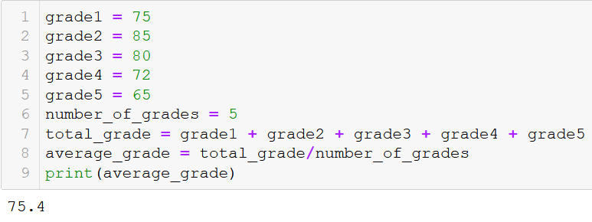
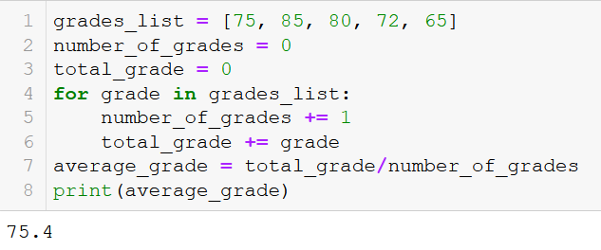
An example: average grade for student
Not using a for loop
Using a for loop
Lots of variable
Long code
Cleaner and shorter code
Modular (works with any number of grades in list)

Slide 12
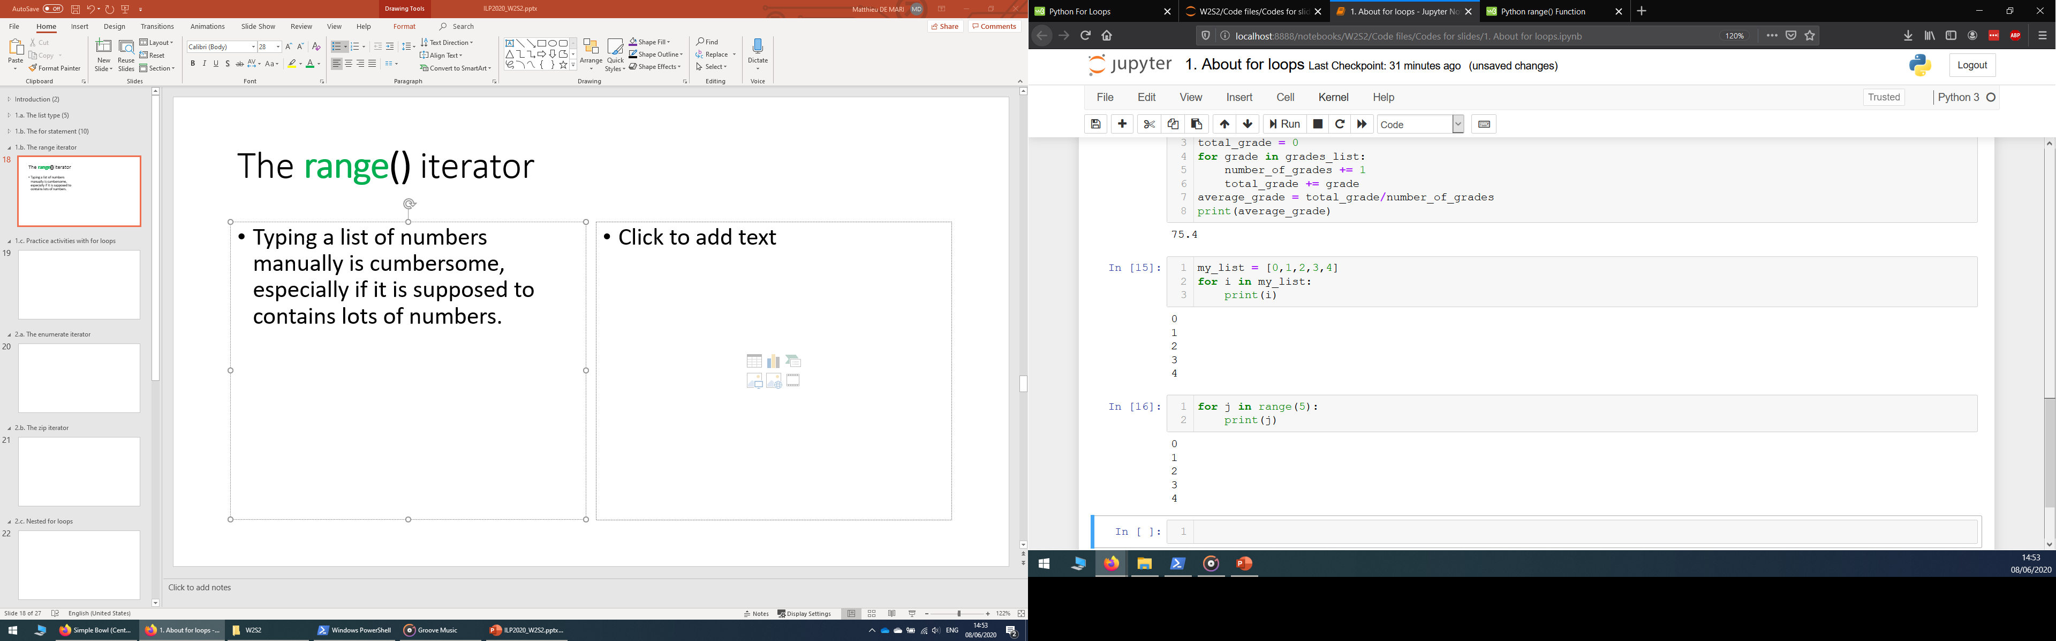
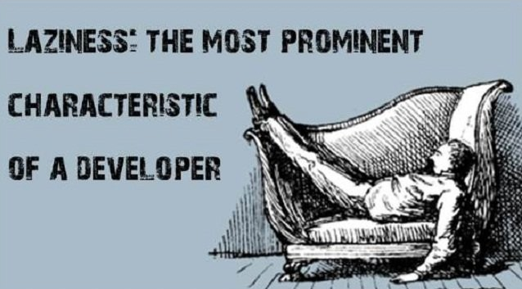
The range() generator
Problem: typing a list of numbers manually is cumbersome, especially if it is supposed to contain lots of elements/numbers.

Slide 13
The range() generator
Solution: The range() generator can be used to replace the list object in the for loop definition.
It receives an integer n.
Here, range(n) means: the iteration variable will take n successive values, starting from 0 and incrementing by 1 each time.

Slide 14
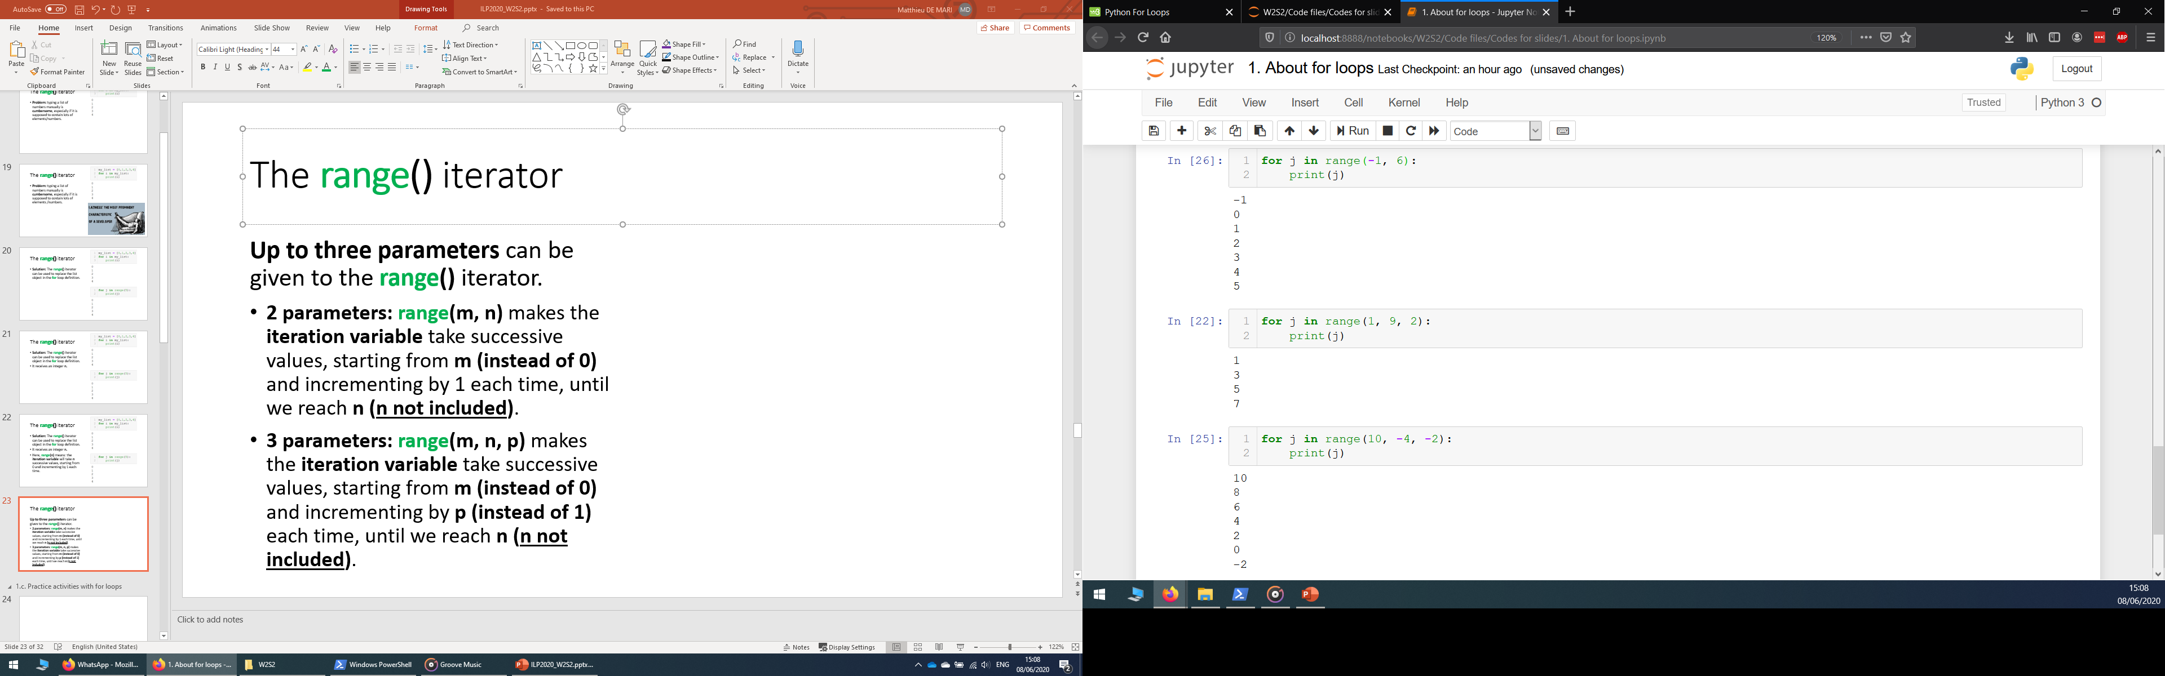
The range() generator
Up to three parameters can be given to the range() generator.
2 parameters: range(m, n) makes the iteration variable take successive values, starting from m (instead of 0) and incrementing by 1 each time, until we reach n (with n not included).

Slide 15
The range() generator
Up to three parameters can be given to the range() generator.
3 parameters: range(m, n, p) makes the iteration variable take successive values, starting from m (instead of the default value 0) and incrementing by p (instead of the default value 1) each time, until we reach n (again, n not included).
Note: Can use negative values as m, n and p.

Slide 16
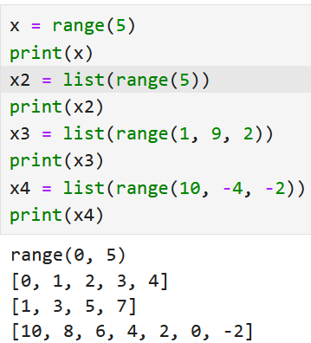
The range() generator hides a list (almost)
The range() generator “hides” a list (almost), in the sense that it gives instructions on how to generate a list.
If you ask Python to print the result of a range(), not that useful…!
But ask it to convert the range() into a list and then print it… You should be able to visualize the list!

Slide 17



Please download and install the Slido app on all computers you use
Which of the following correctly describes the range(5) function?
ⓘ Start presenting to display the poll results on this slide.

Slide 18
Please download and install the Slido app on all computers you use
How many prints will appear on screen?
ⓘ Start presenting to display the poll results on this slide.

Slide 19
Please download and install the Slido app on all computers you use
How many prints will appear on screen?
ⓘ Start presenting to display the poll results on this slide.

Slide 20
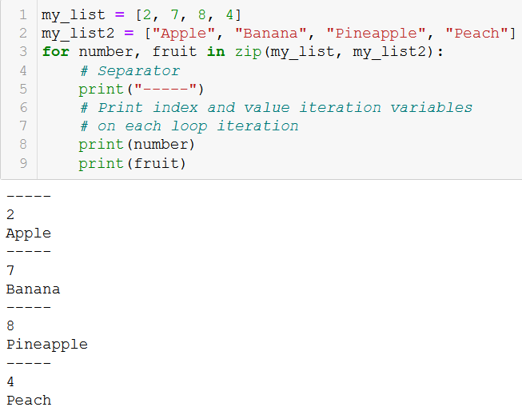
The zip() generator
Want to browse through the elements of multiple lists at the same time?
The zip() generator takes multiple lists of equal length (same number of elements).

Slide 21
The zip() generator
Want to browse through the elements of multiple lists at the same time?
The zip() generator takes multiple lists of equal length (same number of elements).
Updates that many iteration variables on each loop iteration, in a synchronized manner (moves both iteration variables at the same speed on both lists)

Slide 22
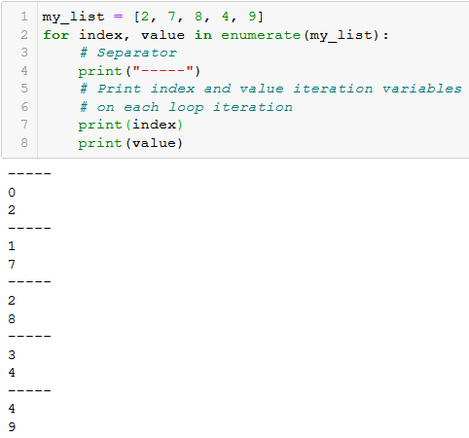
The enumerate() generator
The enumerate() generator can be used to update two iteration variables at once.
On each loop iteration:
The first one takes values consisting of the position index (1st, 2nd,3rd,… element),
The second is takes value of the element in the list.

Slide 23
The enumerate() generator
The enumerate() generator can be used to update two iteration variables at once.
On each loop iteration:
The first one takes values consisting of the position index (1st, 2nd,3rd,… element),
The second is takes value of the element in the list.
Note: In Python, we start counting from 0. What we call the 1st element of the list in English, is called the 0th element (index = 0) in programming.

Slide 24
Please download and install the Slido app on all computers you use
What will be displayed when running the following code? (Careful, there might be something sketchy about it!)
ⓘ Start presenting to display the poll results on this slide.

Slide 25
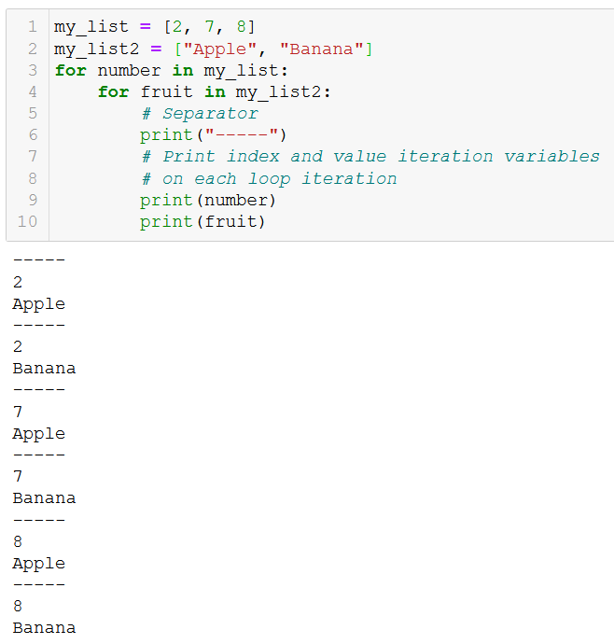
Nesting for loops
Just like we nested if statements earlier, we can nest for loops.
Works “almost” like the zip generator,
But updates the iteration variables in an unsynchronized manner.
Convenient for checking all combinations of values in two given lists!

Slide 26
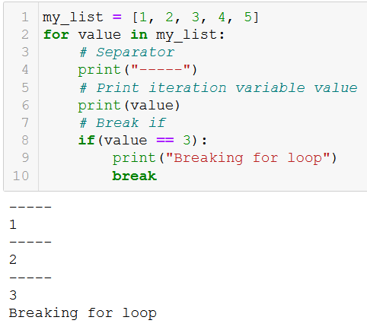
The break statement (episode 2)
In a previous lecture, we have seen how the break statement is used to interrupt a while loop.
It also works with for loops!
When the break keyword is encountered in a for loop, it will stop the iterations early, before we have been able to see all elements in the list/generator.

Slide 27

The continue statement
Similar to the break statement, which was be used to interrupt a while/for loop…
We can define the continue statement!
When encountered in the indented code inside a for loop, it ends the current iteration and moves on to the next one.

Slide 28
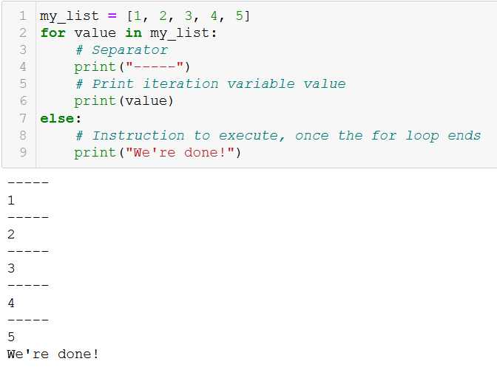
The else statement (episode 2)
Similar to the else statement, which was used in if statements…
We can define the else statement in for loops.
It defines a piece of code to be executed when the for loop ends normally.
Normally: completed all iterations, without being interrupted by a break.

Slide 29
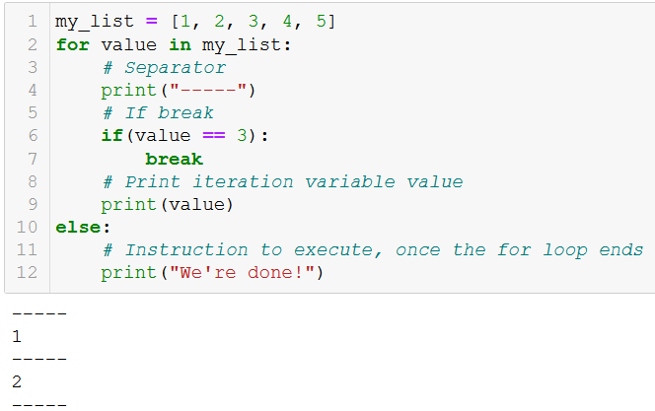
The else statement (episode 2)
Similar to the else statement, which was used in if statements…
We can define the else statement in for loops.
It defines a piece of code to be executed when the for loop ends normally.
Normally: completed all iterations, without being interrupted by a break.

Slide 30
Please download and install the Slido app on all computers you use
Which values will be displayed when we execute this code?
ⓘ Start presenting to display the poll results on this slide.

Slide 31
To recap
We have seen multiple ways to make for loops work
Pass a list: easiest way, browse through each element one by one.
The range() generator: Replace a list of regularly spaced values with a range() generator, as to avoid having to type the elements of the list manually.
The zip() generator: Browse through multiple lists elements in a synchronized manner. Useful for one-to-one matchings between lists.
The enumerate() generator: Updates two iteration variables at once, one being the position index of the element in the list, and the second being the value of said element in list.
Nesting for loops: Browse through multiple lists elements in an unsynchronized manner. Useful for checking all combinations.

Slide 32
Conclusion (Chapter 6)
What is the list type? (quick intro, more on this later)
What is a for loop and how to implement a basic one using a list as generator?
What is the range() generator?
What is the zip() generator?
What is the enumerate() generator?
What are nested for loops?
What is breaking and continuing in for loops?

Slide 33
Practice activities: basic for loops
Let us practice a bit with for loops, with the following activities
Activity 1 - How many items in my inventory.ipynb
Activity 2 - Best equipment finder.ipynb
Activity 3 - Best equipment finder v2.ipynb
Activity 4 - Find the missing card.ipynb

Slide 34
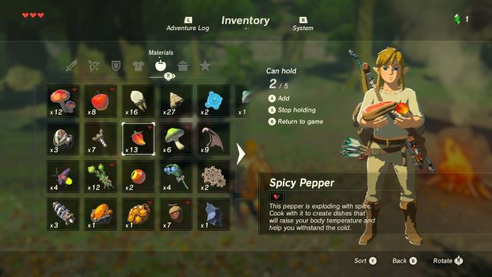
Activity 1 - How many items in my inventory
In several video games, the main character will have an inventory system, i.e. a list of items that he/she is carrying at the moment.

Slide 35
Activity 1 - How many items in my inventory
In several video games, the main character will have an inventory system, i.e. a list of items that he/she is carrying at the moment. This inventory could be defined as a list, as shown below.
inventory = ["Sword", "Armor", "Potion", "Potion", "Torch", "Potion", "Bow", "Potion", "Torch", "Potion"]
Our objective is to write a function how_many_items(), which:
receives an inventory list, such as the one above, as its first parameter,
receives an item name, as a second parameter (e.g. item_name = "Torch")
and returns the number of times the item in question appears in the inventory.

Slide 36
Activity 2 - Best equipment finder
Let us define an inventory list, below, which contains a list of weapons that our character has acquired during gameplay.
inventory = ["Dull Sword", "Wooden Branch", "Master Sword", "Iron Sword", "Silver Sword"]
Let us also consider we have been given a second list, which contains the attack points for each weapon currently in inventory, in order:
weapon_stats = [1, 1, 10, 5, 8]
Write a function maximal_attack_points(), which
receives the weapon_stats list as its only parameter,
and returns the maximal attack points we would have if we were to equip the best weapon currently in inventory.

Slide 37
Activity 3 - Best equipment finder v2
Let us define an inventory list, below, which contains a list of weapons that our character has acquired during gameplay.
inventory = ["Dull Sword", "Wooden Branch", "Master Sword", "Iron Sword", "Silver Sword"]
Let us also consider we have been given a second list, which contains the attack points for each weapon currently in inventory, in order:
weapon_stats = [1, 1, 10, 5, 8]
Task: As in activity 2, but I want the name of the best weapon to be returned instead of the maximal attack points I would obtain if I decided to equip it!

Slide 38
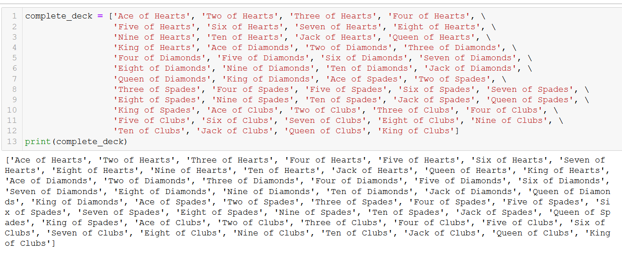
Activity 4 - Find the missing card

Slide 39
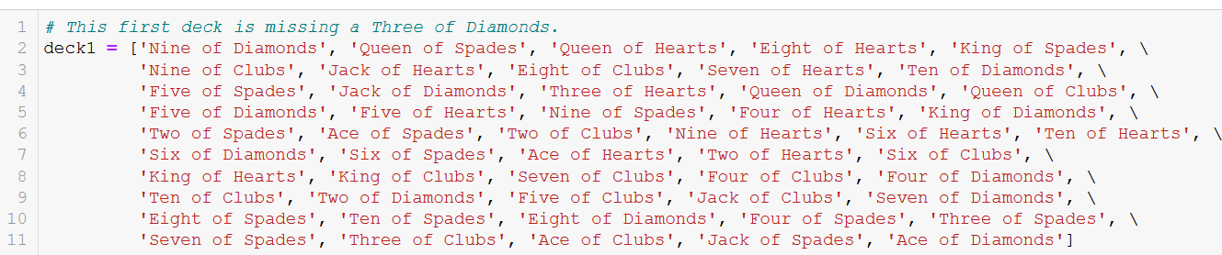
Activity 4 - Find the missing card

Slide 40
Activity 4 - Find the missing card
Write a function find_missing_card().
It receives a complete deck of cards as its first parameter, and receives a second deck, as its second parameter.
The second deck is a standard deck that has been shuffled and is missing exactly one card at most.
The function find_missing_card() should return the name of the one card that is missing in the second deck. It should return None, if no card is missing.
The incomplete decks are missing one card at most (or none) and contain no duplicates or cards that are not in the complete deck.

